Slide 1

Exploring Ten Years of Crime in Philadelphia
By
Rajat Handa

Slide 2

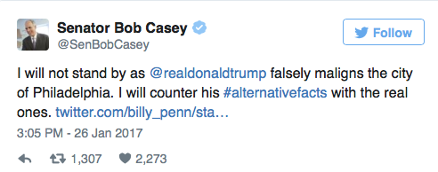
Motivation

Slide 3
Layout
Exploratory Data Analysis.
Comparative Analysis.
Spatial Analysis.
Time series Forecasting.

Slide 4

Exploratory Data Analysis

Slide 5
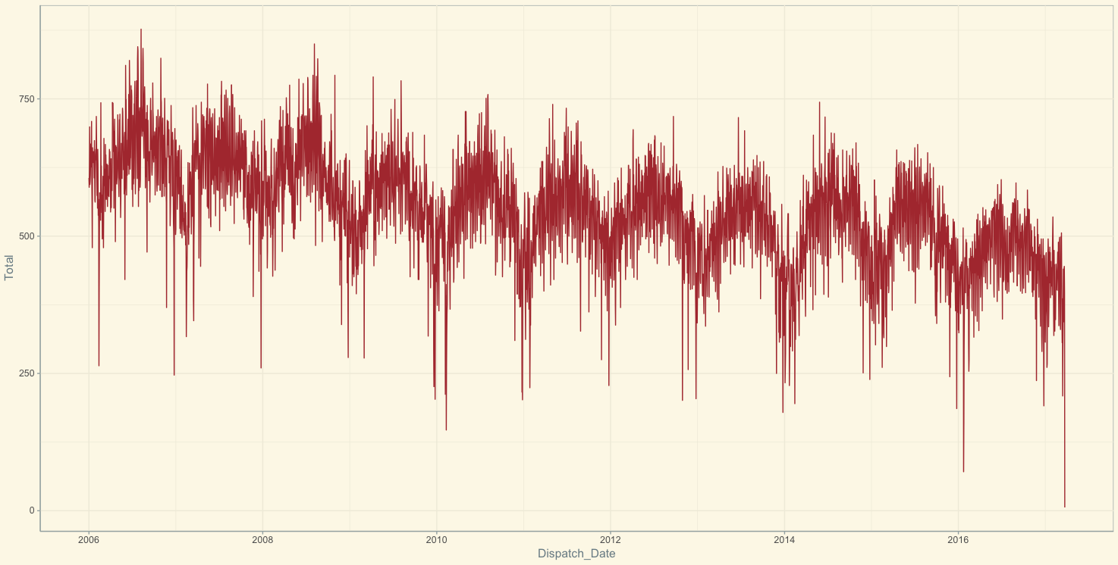
Crimes by Year

Slide 6
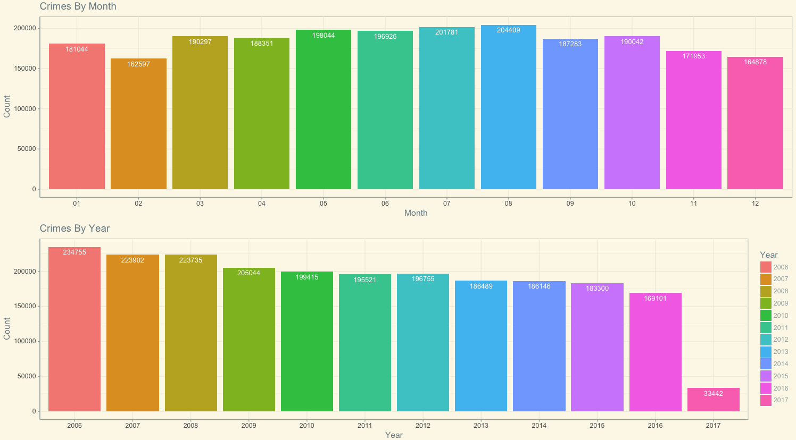
Crimes by Year & Month

Slide 7
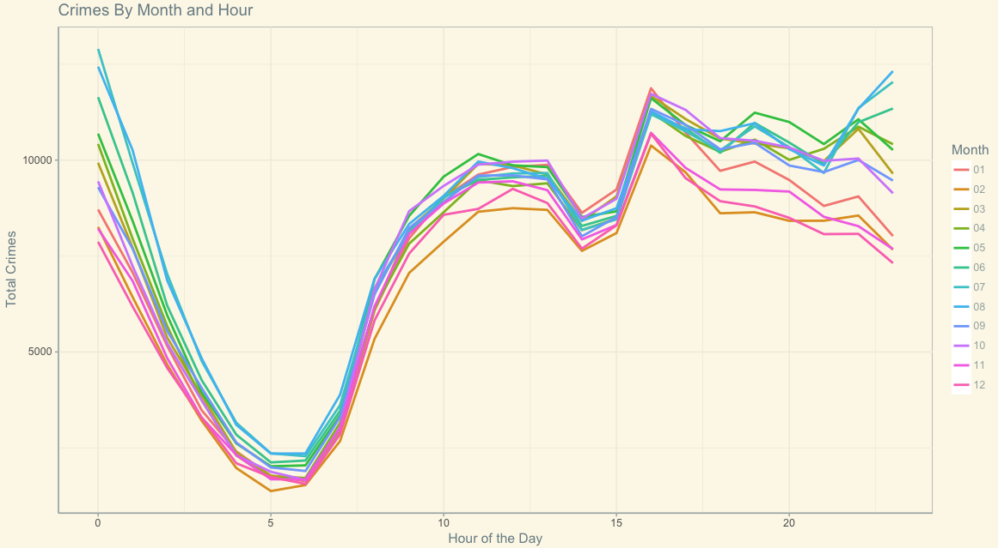
Crimes by Hour & Month

Slide 8
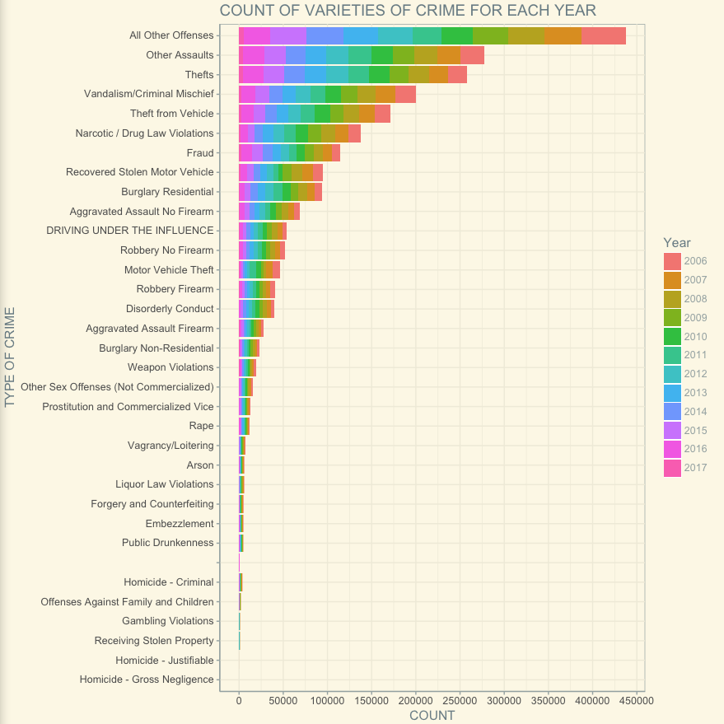
Count of Various types of crime for each year

Slide 9
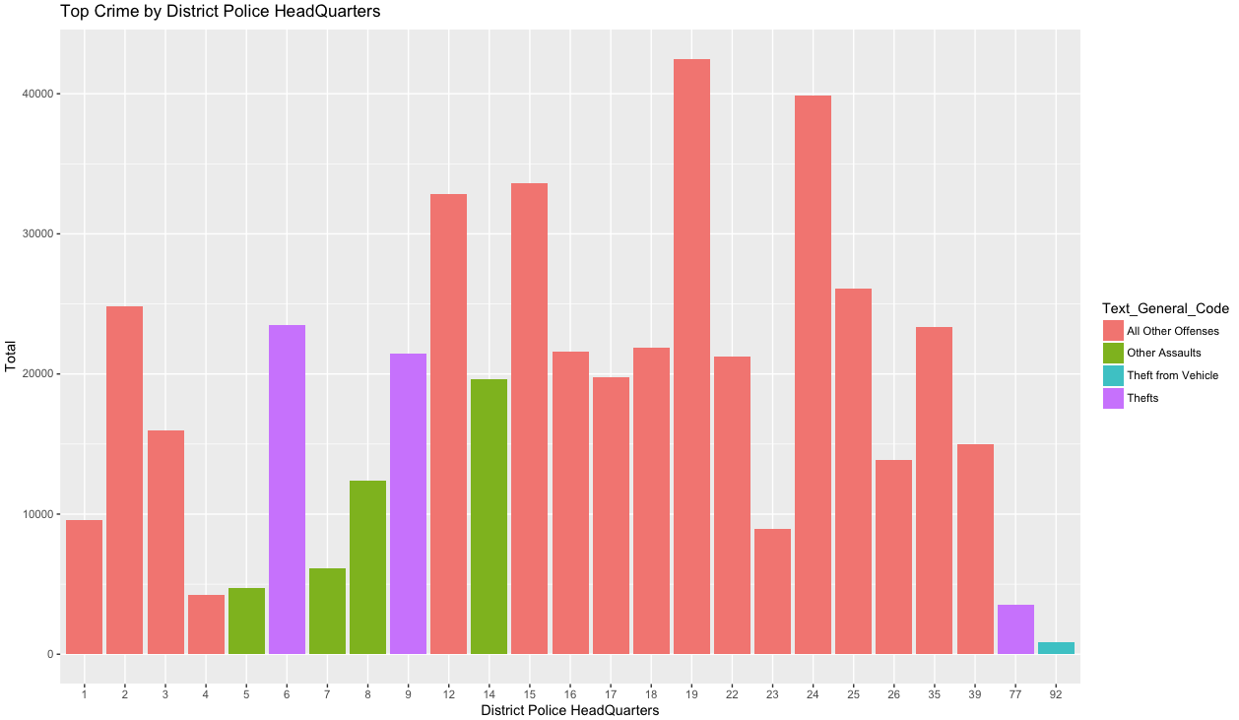
Top crimes in Police Headquarters

Slide 10

Comparative Analysis

Slide 11
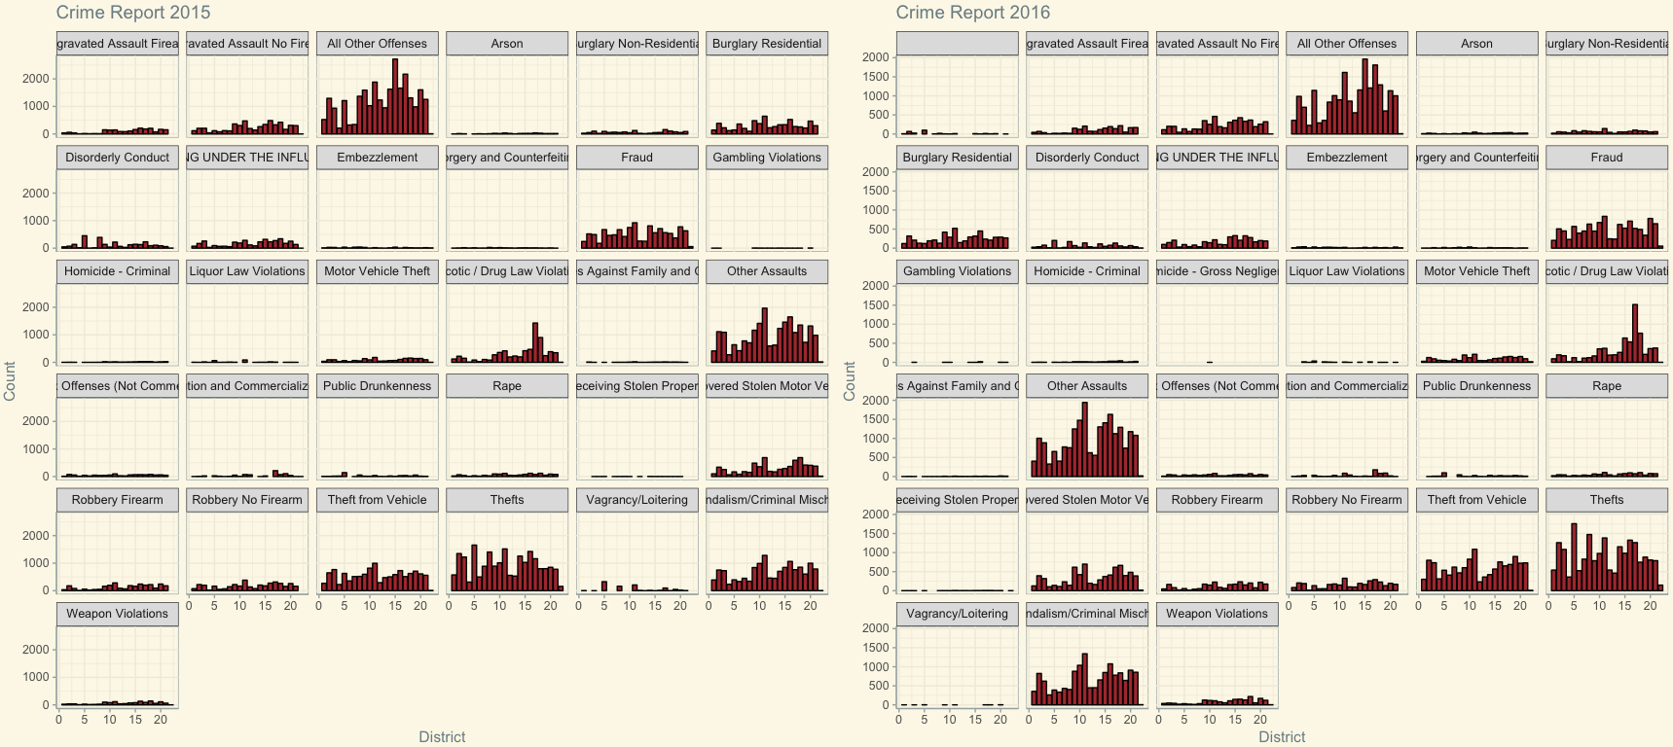
Crime Report for 2015-2016

Slide 12
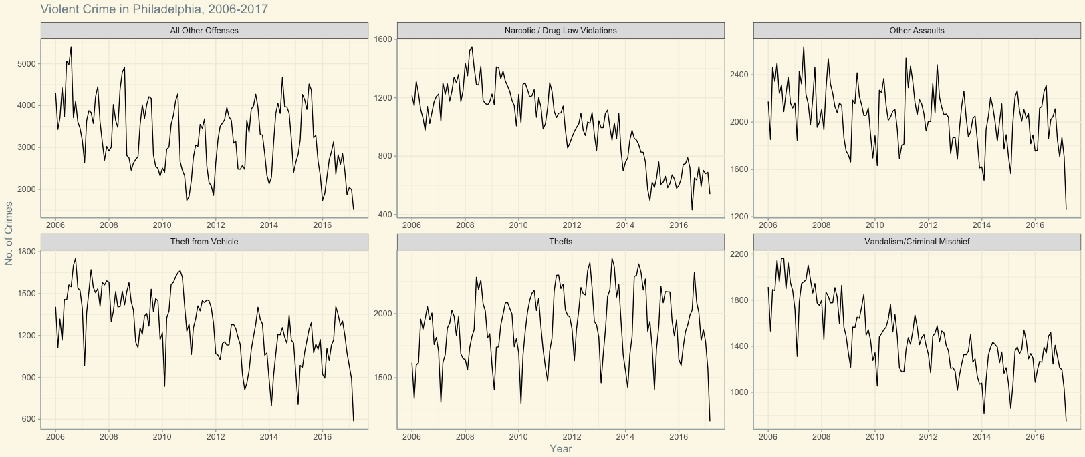
Top 6 Crimes, 2006-2017

Slide 13

Spatial Analysis

Slide 14
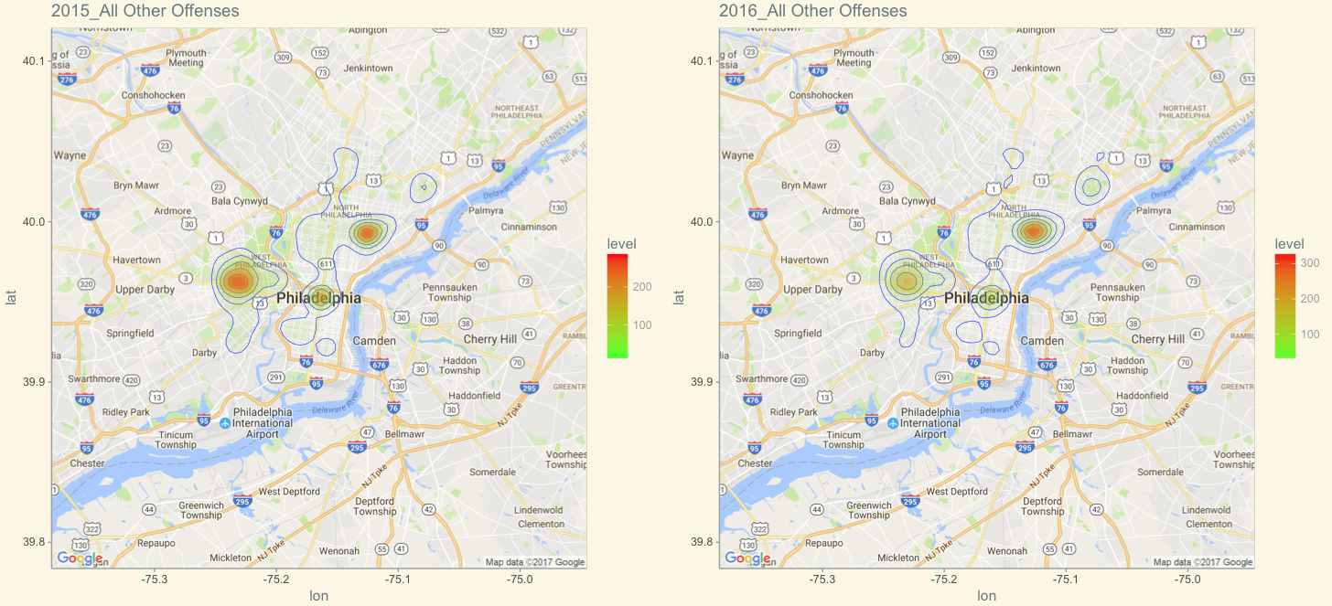
2015-2016, All Other Offenses

Slide 15
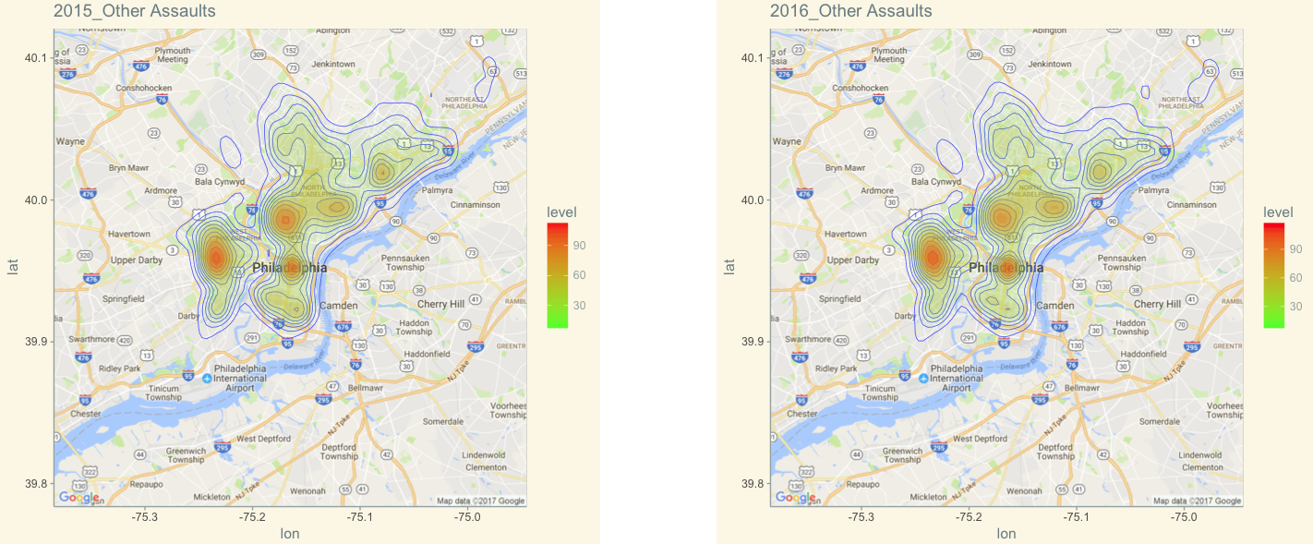
2015-2016, Other Assaults

Slide 16
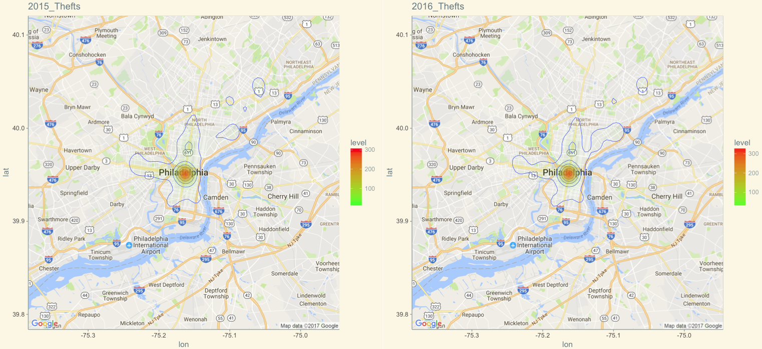
2015-2016, Thefts

Slide 17
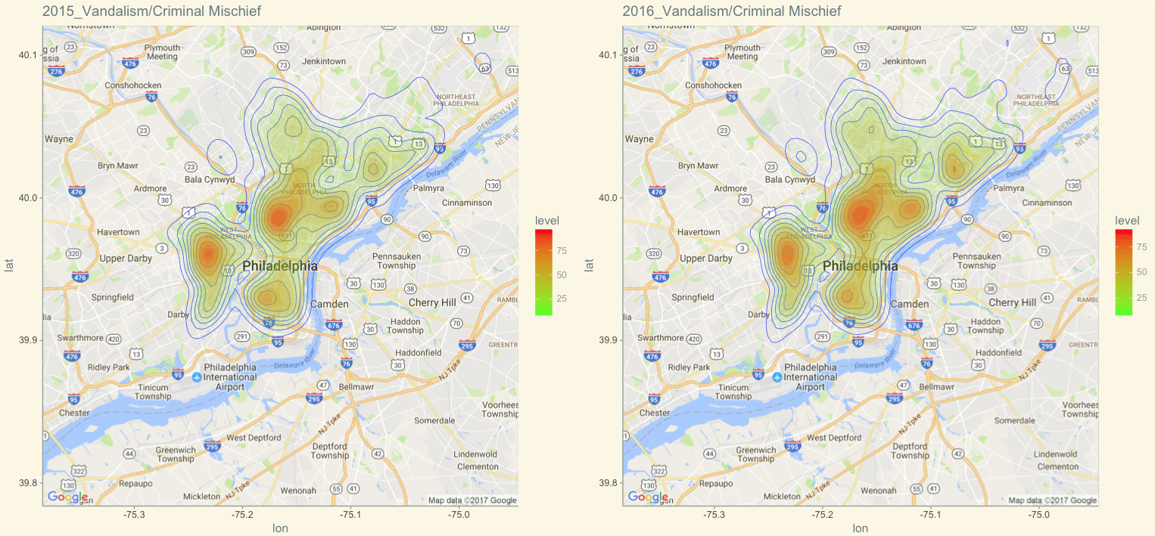
2015-2016, Vandalism/Criminal Mischief

Slide 18
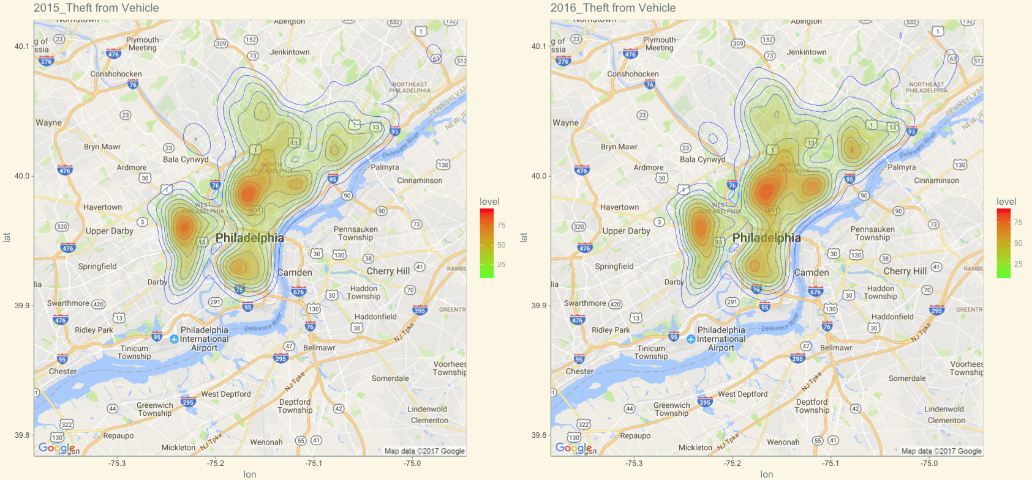
2015-2016, Theft from vehicle

Slide 19
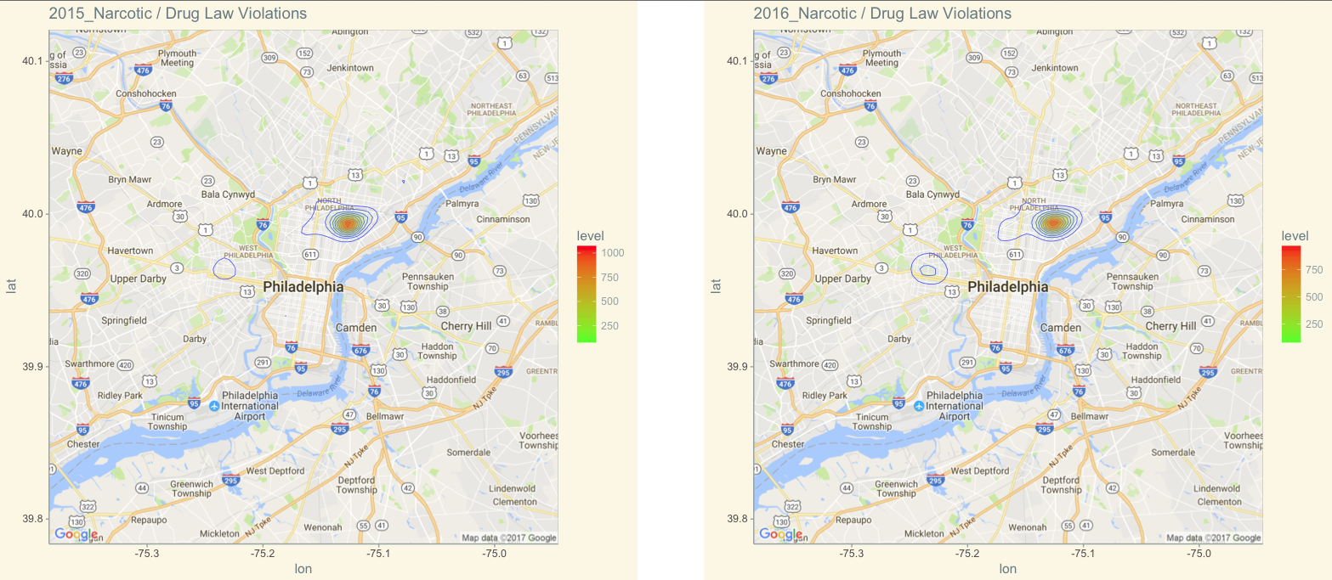
2015-2016, Narcotic/Drug law

Slide 20

Time series Forecasting

Slide 21
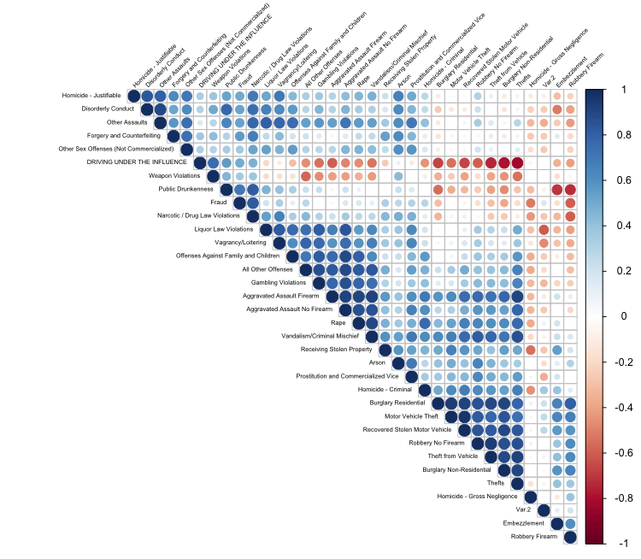
Correlation Plot

Slide 22
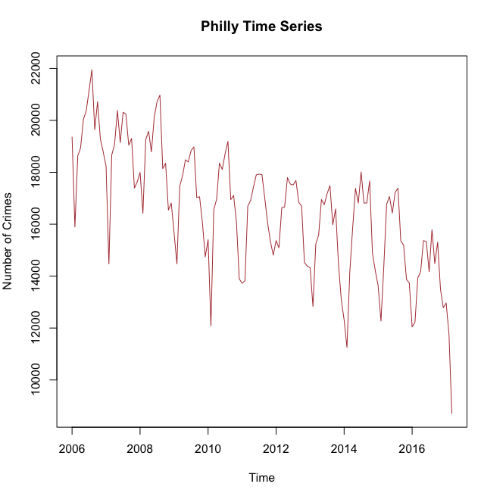
Time Series

Slide 23
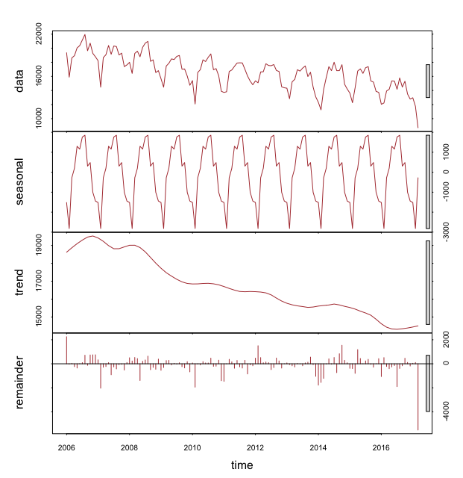
Trend & Seasonality

Slide 24
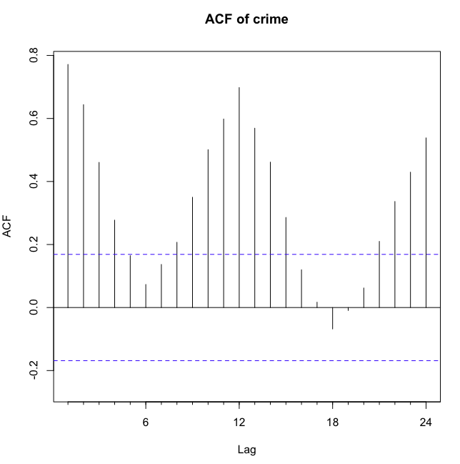
ACF Plot

Slide 25
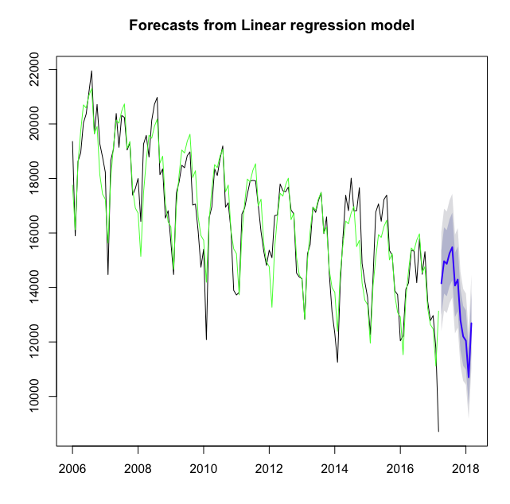
Linear regression model

Slide 26
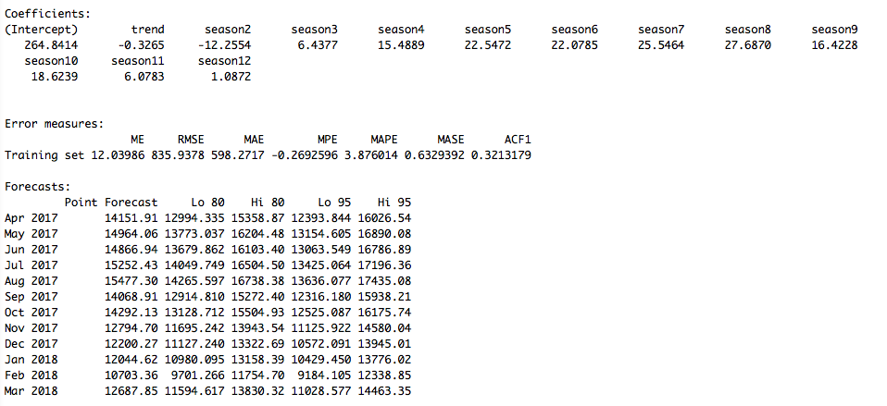
Model Summary

Slide 27
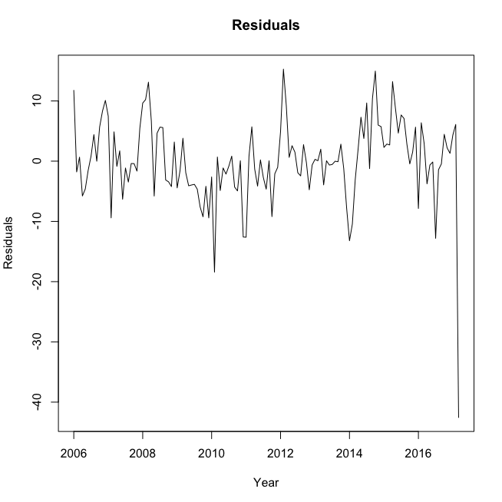
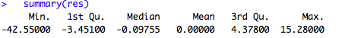
Residual plot

